Slide 1
Advanced Embedded System Final Project Presentation-Team Delta
Jiajia Liang, Zongdi Qiu, CJ Rogers

Slide 2
Project Features
Part I:
Well-functioning cube game with deadlock prevention
Part II:
Using accelerometer to control the crosshair
Night Mode: Using light sensor to adjust LCD brightness
Multi-level game

Slide 3
Design and Implementation -Part I Flowchart
Periodic thread
Foreground thread
Joystick
JsFiFo
ADC
Producer1
Consumer
Periodic thread
SW2Push
Restart
LCD
Cube Move calculation
Cube Move
CubeThread
RanNum generator
Foreground thread

Slide 4
Design and Implementation -Part II Flowchart
Periodic thread
Foreground thread
Accel
JsFiFo
ADC
Producer1
Consumer
Game Logic
Light sensor
I2C Communication
Producer2
PWM Signal
LCD
Periodic thread
SW2Push
Restart
Cube Move calculation
Cube Move
CubeThread
RanNum generator
Foreground thread

Slide 5
Design and Implementation - Deadlock Prevention
6*6 semaphores for each blocks (0 = occupied, 1 = free)
New Direction
False
Move cube
Feasible?
True
Update position
Not Wall
Block is free

Slide 6
Design and Implementation - Accelerometer
Similar to Joystick
Control by tilting the board
Alter ADC to use Accelerometer instead of joystick
Change ACD used
Make sure the correct pins are used
Initialize registers according to pins used
Might not need all three inputs, game only needs two

Slide 7
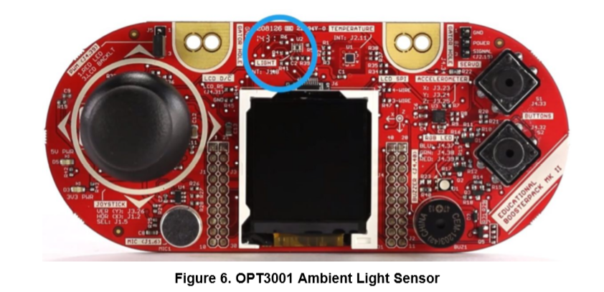
Design and Implementation - Light Sensor
OPT3001 light sensor
Digital ambient light sensor.
SCL: J1.9 SDA: J1.10
I2C communication
Using PWM signal to adjust the brightness

Slide 8

Design and Implementation - Light Sensor

Slide 9
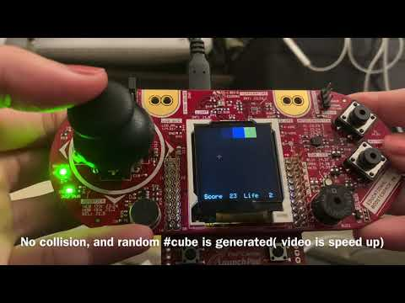
Demo-Part I:

Slide 10
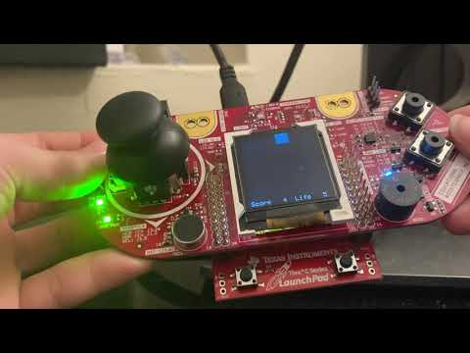
Demo-Part II:

Slide 11
Discussion
Insight and lessons learnt
While they seem very different while using them the methods of implementing the joystick vs. the accelerometer are very similar to one another.
Understand how the I2C bus works.

Slide 12
Team responsibility
Part I:
Jiajia Liang:
Adding semaphores & Avoid deadlock
Zongdi Qiu:
CubeInit(), ChangeCubePostistion(), MoveCube()
CJ Rogers:
CubeThread(), CubeInit(), ChangeCubePostistion(), collision()
Part II:
Jiajia Liang:
Integrate Accelerometer Input into game
Add Game Levels
Zongdi Qiu:
Light Sensor
CJ Rogers:
ADC Configuration for Accelerometer

